Slide 1
EE451: High Voltage Engineering
Lecture 13

Slide 2
Outline
Breakdown Mechanism in Liquids
Liquid dielectrics
Transformer oil
Pure liquids and commercial liquids
Breakdown in liquid dielectrics
Breakdown in pure liquids
Breakdown in commercial liquids
Page 2

Slide 3



Liquid Dielectrics
Liquid dielectrics are used as insulating medium in transformers, arc extinghuishers in circuit breakers and impregnants in high voltage cables and capacitors.
Liquid dielectrics are more useful as insulating materials than either solids or gases.
This is because both liquids and solids are usually 10³ times denser than gases and hence, from Paschen's law it should follow that they possess much higher dielectric strength of the order of 10⁷ V/cm.
Liquids are expected to give very high dielectric strength of the order of 10 MV/cm, but, in actual practice, the strengths obtained are only of the order of 100 kV/cm.
Oil is about 10 times more efficient than air or nitrogen in its heat transfer capability when used in transformers.
Page 3

Slide 4
Liquid Dielectrics
Commonly used liquid dielectrics:
Mineral oils
N-hexane
N-heptane
Castor oils
Silicon oils
Liquid nitrogen
Page 4

Slide 5
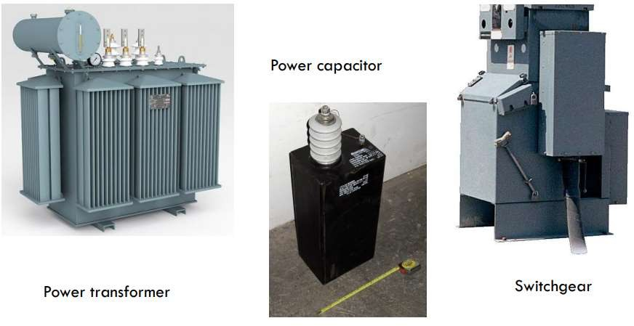
Liquid Dielectrics
Page 5

Slide 6

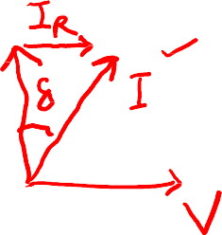

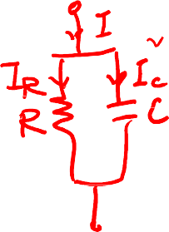
















Liquid Dielectrics
The three most important electrical properties of liquid dielectric are:
Dielectric strength
Relative permittivity
Loss tangent
Basic properties of insulating oil:
Viscosity
Thermal stability
Density and specific gravity
Flash point
Pour point
Page 6

Slide 7
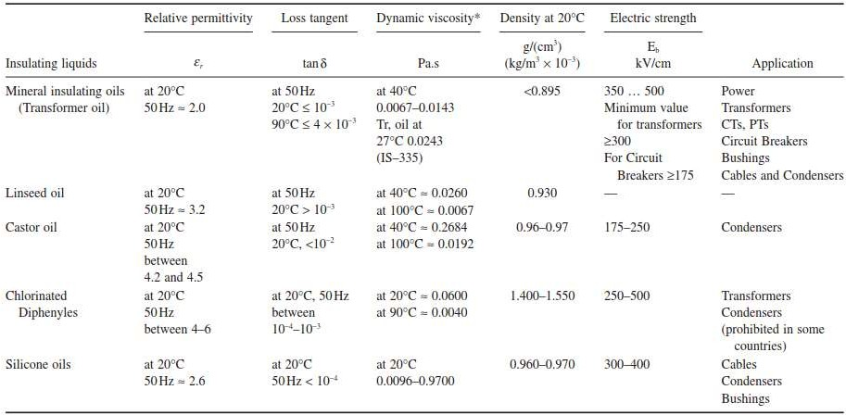






Liquid Dielectrics
Page 7

Slide 8

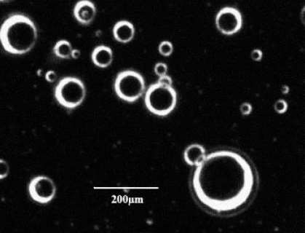



Liquid Dielectrics
Major impurities present in liquid dielectrics are:
Fine water droplets and water vapours
Dust
Carbon and sulphur ions
Dissolved gases CO₂
The presence of even 0.01% water in oil brings down the dielectric strength to 20% of the dry oil value and the presence of fibrous impurities brings down the dielectric strength much sharply.
Therefore, whenever these oils are used for providing electrical insulation, these should be free from moisture, products of oxidation and other contaminants.
Page 8

Slide 9


Transformer Oil
Transformer oil is the most commonly used liquid dielectric in power apparatus.
It is a mineral oil consisting a mixture of hydrocarbons which include paraffins, iso- paraffins, naphthalenes and aromatics.
When in service, the liquid in a transformer is subjected to prolonged heating at high temperatures of about 95ºC, and consequently it undergoes a gradual ageing process.
With time, the oil becomes darker due to the formation of acids and resins, or sludge in the liquid.
Deposits of sludge on the transformer core, on the coils and inside the oil ducts reduce circulation of oil and thus its heat transfer capability gets considerably reduced.
Page 9

Slide 10
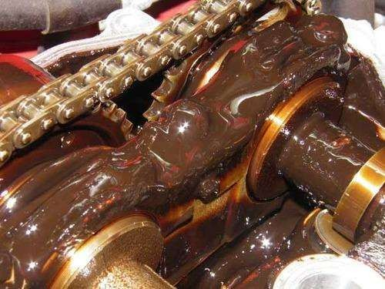

Transformer Oil
Page 10

Slide 11
Pure Liquids and Commercial Liquids
Pure liquids are those which are chemically pure and do not contain any other impurity even in traces of 1 in 10⁹ and are structurally simple.
Examples: n-hexane (C₆H₁₄), n-heptane (C₇/H₁₆) and other paraffin hydrocarbons.
Commercial liquids which are insulating liquids like oils are not chemically pure and may have impurities like dust particles, moisture, dissolved gases, gas bubbles, and ionic impurities etc. These impurities reduce the breakdown strength of the liquid dielectrics.
When breakdown occurs in these liquids, additional gases and gas bubbles are evolved and solid decomposition products are formed.

Slide 12


Pure Liquids and Commercial Liquids
The breakdown in pure liquids is explained by:
Electronic breakdown theory
Several theories have been proposed to explain the breakdown in commercial liquids, and they are classified as follows:
Breakdown due to solid particles (suspended particle theory)
Breakdown due to gaseous bubbles
Breakdown due to liquid globule

Slide 13
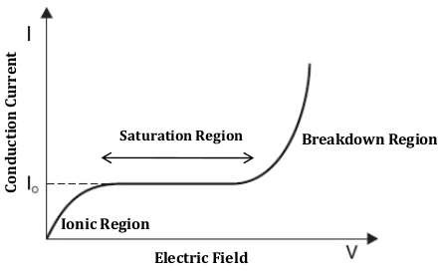
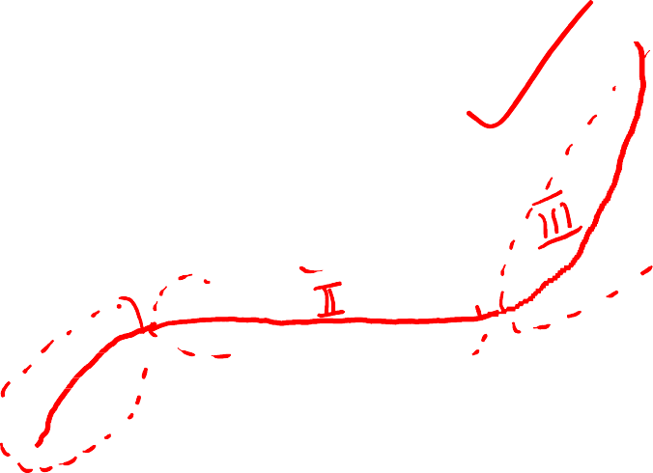
Breakdown in Pure Liquids (Electronic BD Theory)
Electronic breakdown theory explains the breakdown in pure liquids on a model which is an extension of gaseous breakdown, based on the avalanche ionization of the atoms caused by electron collision in the applied field.

Slide 14
Breakdown in Pure Liquids (Electronic BD Theory)
It has been observed that low electric field (1 kV/cm), conduction in pure liquids is mainly ionic (due to positive and negative ions) due to dissociation.
At intermediate fields, the conduction saturates but at high field (100 kV/cm), the conduction increases more rapidly and thus, breakdown takes place.
At high fields, the current generated because of the electron emission from the cathode gets multiplied in the liquid medium by a Townsend mechanisms. The current multiplication also occurs from the electrons generated at the interfaces of liquid and impurities.

Slide 15
Breakdown in Pure Liquids (Electronic BD Theory)
The electrons are assumed to be ejected from the cathode into the liquid by either a field emission or by the field enhanced thermionic effect .
Once an electron is injected into the liquid, it gains energy from the electric field applied between the electrodes.
It is presumed that some electrons will gain more energy due to field than they would lose during collision.
These electrons are accelerated under the electric field and would gain sufficient energy to knock out an electron and thus initiate the process of avalanche.

Slide 16
Breakdown in Pure Liquids (Electronic BD Theory)
The threshold condition for the beginning of avalanche is achieved when the energy gained by the electron equals the energy lost during ionization (electron emission) and is given by,
where λ is the mean free path, hv is the energy of ionization and C is a constant.

Slide 17



Breakdown in Commercial Liquids
The impurities which lead to breakdown of liquid dielectrics are:
Bubbles of gas: impurities having lower breakdown strength compared to liquid
Conducting particles: impurities that result in local field enhancement in liquid
Globules of water: impurities that are unstable in an electric field
Several theories have been proposed to explain the breakdown in commercial liquids, and they are classified as follows:
Breakdown due to solid particles
Breakdown due to gaseous bubbles
Breakdown due to liquid globule

Slide 18


Breakdown due to Solid Particles
In commercial liquids, the presence of solid impurities cannot be avoided. These impurities will be present as fibres or as dispersed solid particles.
The permittivity of these particles (ε₂) will be different from the permittivity of the liquid (ε₁).
When the liquid is subjected to an electric field E, the particles will become polarize and experience a force F,
If permittivity of impurities (ε₂) > permittivity of liquid dielectric (ε₁), then the particles get polarized. The force would move the particle along the converging field, that is, towards the regions of stronger field.

Slide 19
Breakdown due to Solid Particles
If the voltage is continuously applied (d.c) or the duration of the voltage is long (a.c), then this force drives the particles towards the area of maximum stress.
When a particle reaches either electrode, its outward tip will act as an extension to the electrode and attract more fibers.
Thus, a stable chain of particles is formed bridging the gap and causing a breakdown between the electrodes.
If there is only a single conducting particle between the electrodes, it will give rise to local field enhancement depending on its shape.
If this field exceeds the breakdown strength of the liquid, local breakdown will occur near the particle, and this will result in the formation of gas bubbles which may lead to the breakdown of the liquid.

Slide 20

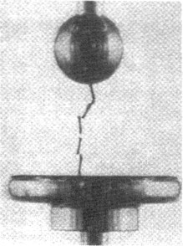
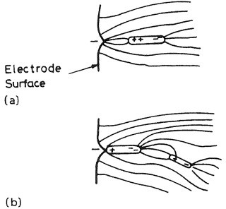

Breakdown due to Solid Particles
Page 20

Slide 21

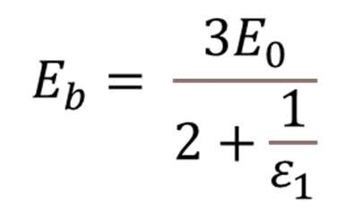
Breakdown due to Gaseous Bubbles
Following processes might lead to formation of bubbles of gases in the liquids:
Changes in temperature and pressure
Gas pockets exist on the surface of electrodes
Due to irregular surface of electrodes, point charge concentration may lead to corona discharge, thus vaporizing the liquid
The electric field in a gas bubble that is immersed in a liquid of permittivity Ɛ₁ is,
where E₀ is the field in the liquid dielectric in the absence of bubbles.
Page 21

Slide 22
Breakdown due to Gaseous Bubbles
When the field E_{b} becomes equal to the limiting field for gaseous ionization, a discharge will take place through the bubble.
This will result in gas formation through decomposition of oil molecules and may lead to breakdown of the gap.
If on the electrodes there are spots at which current density is very high, at sufficiently high fields, vaporization of the liquid may take place at these points.
A discharge through the vapor bubble will result in formation of a stable gas volume and may lead to breakdown when the bubble bridges the gap.
Page 22

Slide 23
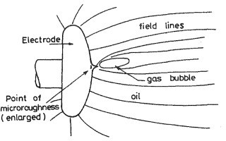
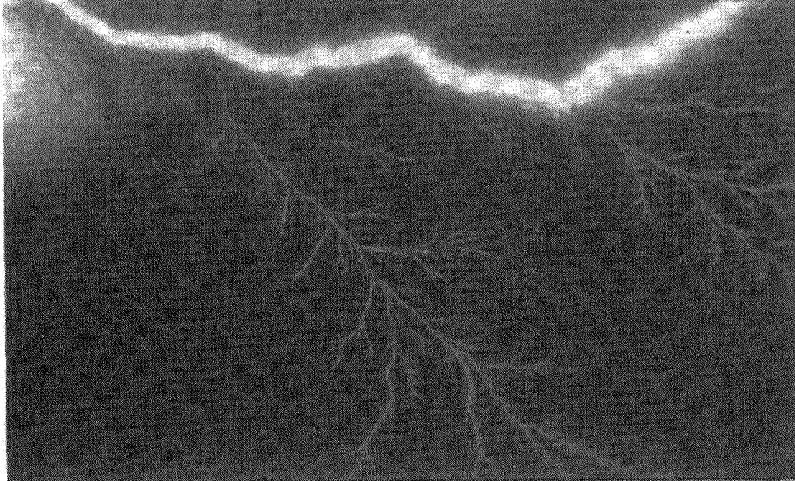
Breakdown due to Gaseous Bubbles
Fig. Formation of a gas bubble at a point at the point of micro-roughness on the electrode surface in an oil gap
Fig. Gas discharge in the bubble, developing in into branched streamers with ultimate breakdown
Page 23

Slide 24
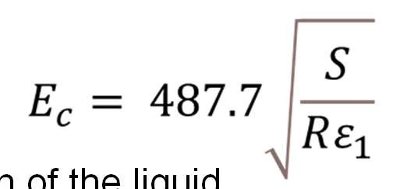





Breakdown due to Liquid Globule
Consider an incompressible liquid globule of permittivity ε₂ is immersed in a liquid of permittivity ε₁ and the gap is subjected to an electric field E, it will elongate in the direction of the field, taking the shape of a prolate spheroid.
An expression for the critical field, which causes instability in the liquid, is given for the case where the ratio ε₂ / ε₁ → ∞ as,
Where S = surface tension of the liquid R = radius of the globule
Page 24

Slide 25
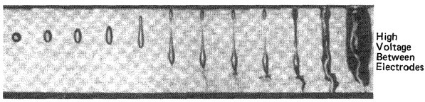

Breakdown due to Liquid Globule
Breakdown will occur when the globule becomes unstable and elongates rapidly reaching about two-thirds of the gap and breakdown channels developed at the end of the globule.
Propagation of the channels across the remaining gap result in total breakdown
Fig. Water drop being gradually elongated by electric field and ultimately causing breakdown. The water is evaporated by discharge
Page 25

Slide 26
THANK YOU FOR YOUR ATTENTION

